Slide 1




Investigating The Correlation Between Inversion Strength Proxies and Cloud Fraction
Author: Annalisa Minke,
Mentors: Xubin Zeng, Michael Brunke, Lauren Cutler, Rodrigo Delgado
Special Thanks To: University of Arizona Hydrology and Atmospheric Sciences Department, Arizona NASA Space Grant Consortium

Slide 2
Introduction
Low Level clouds have a strong effect on the radiation balance of the earth
They are created by layers of warm air called inversion layers in the atmosphere
The inversions have been estimated and predicted using Estimated Inversion Strength (EIS), and Lower Tropospheric Stability (LTS)

Slide 3
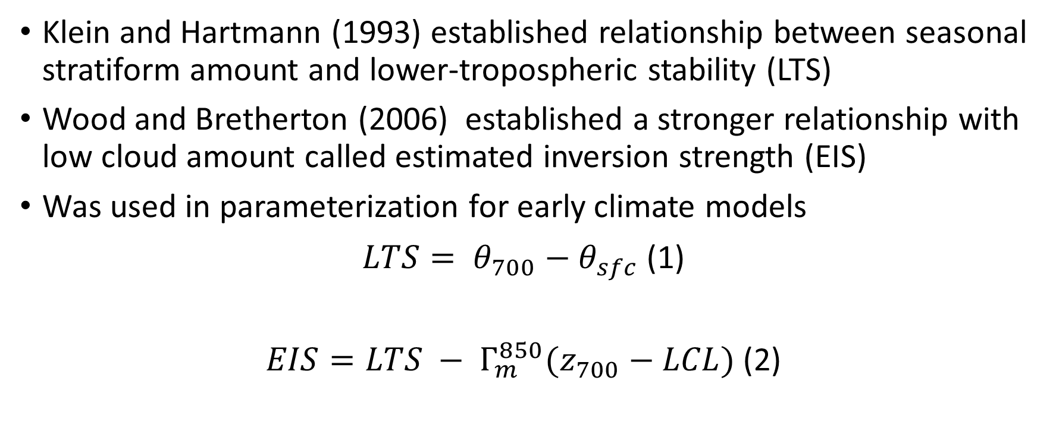
Estimated Inversion Strength and Lower Tropospheric Stability
Klein and Hartmann (1993) established relationship between seasonal stratiform amount and lower-tropospheric stability (LTS)
Wood and Bretherton (2006) established a stronger relationship with low cloud amount called estimated inversion strength (EIS)
Was used in parameterization for early climate models
$LTS= θ_{700}−θ_{sfc}$ (1)
$EIS=LTS − Γ_{m}^{850}(z_{700}−LCL)$ (2)

Slide 4
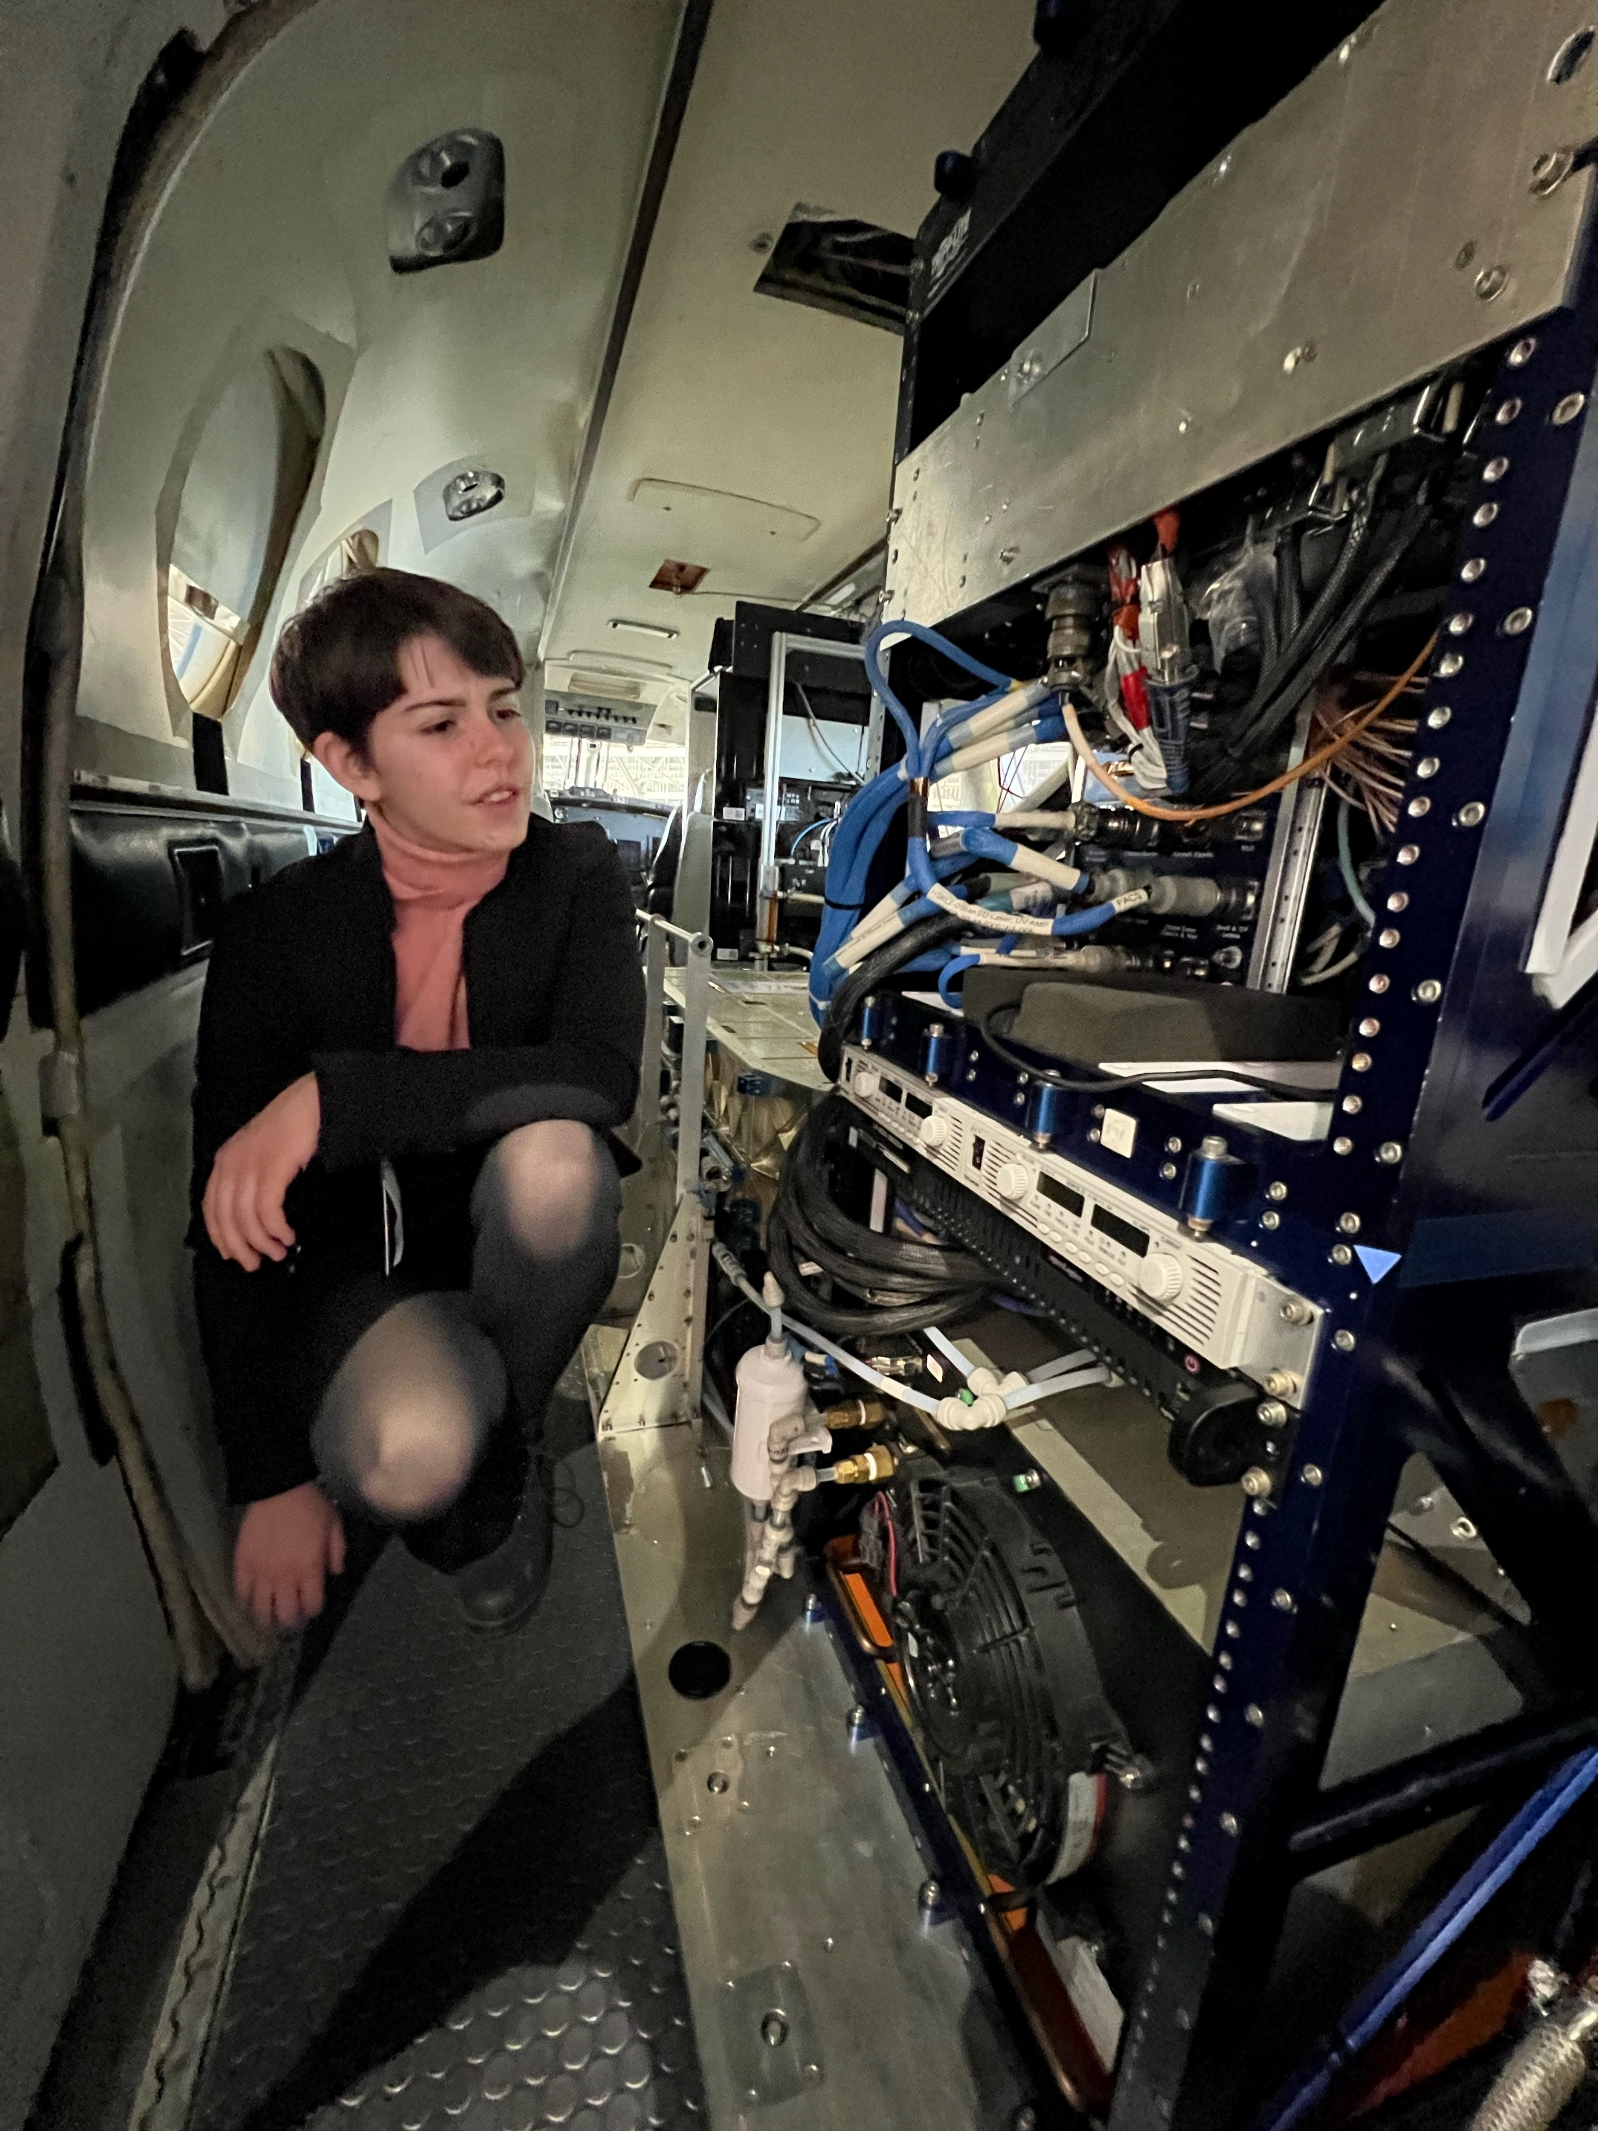
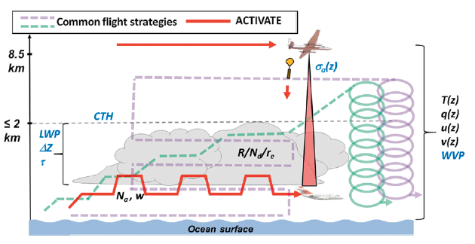
Data
Data is collected in the ACTIVATE campaign
ACTIVATE uses two airplanes to measure clouds
Used data from years 2020 and 2021
Dropsonde
  Temperature
  Dew point Temperature
  Pressure
HSRL-2
  Cloud fraction

Slide 5
Method
LTS and EIS
  Calculated from all dropsonde data using formulas as earlier
Cloud fraction
  Split into 10-minute increments centered around dropsonde launch point
  Calculated by dividing the number of times the HSRL-2 found a low-level cloud which is less than 3 km, by the number of times it looked in the 10-minute increment
Performed linear regression of CF vs. LTS and CF vs. EIS
  Separated the data seasonally to see if the relationship changes with season by only graphing data from a given season
  Binned the data by grouping EIS and LTS values to see if that changes the relationship

Slide 6
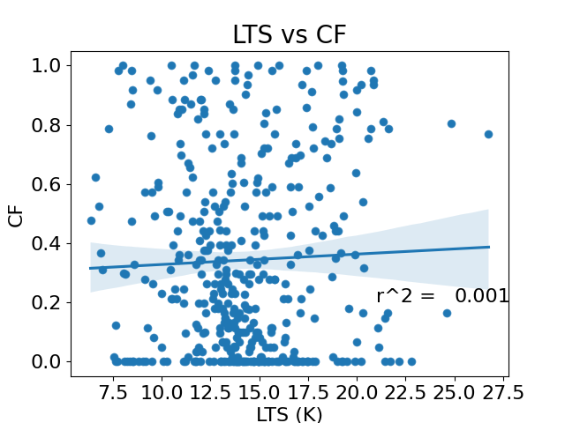
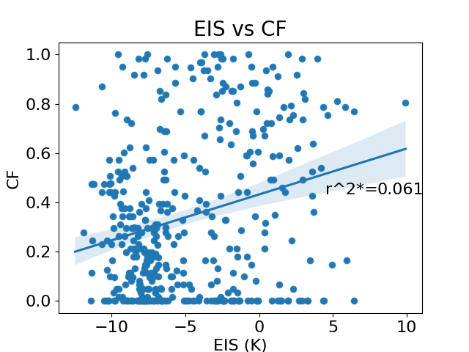
Results
The regression between LTS and Cloud Fraction and EIS and Cloud Fraction using all dropsonde data

Slide 7
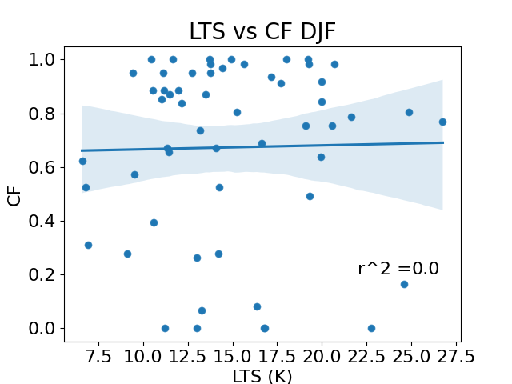
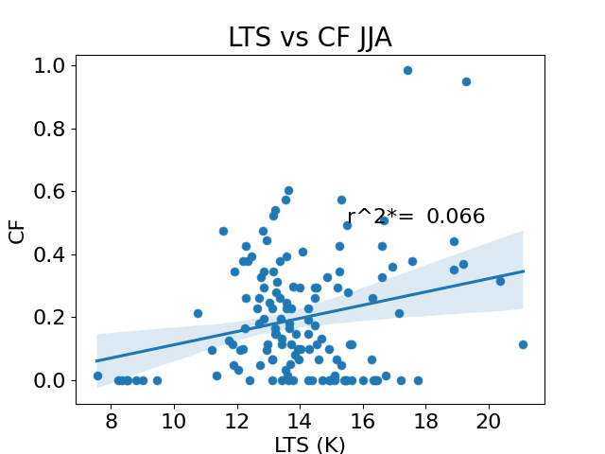
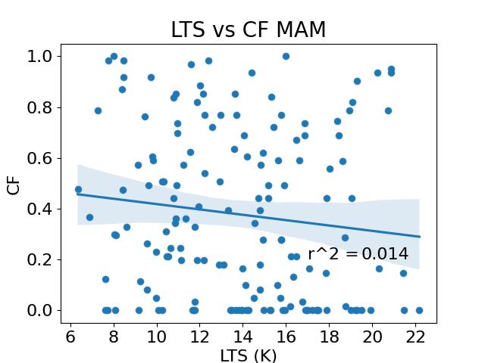
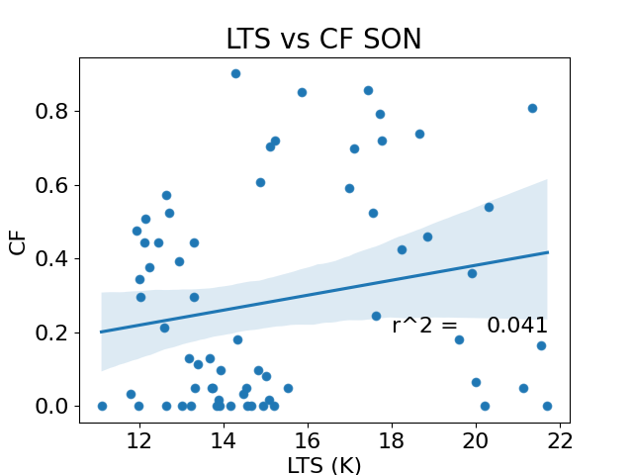
Results
The regression between LTS and Cloud Fraction when separated by season

Slide 8
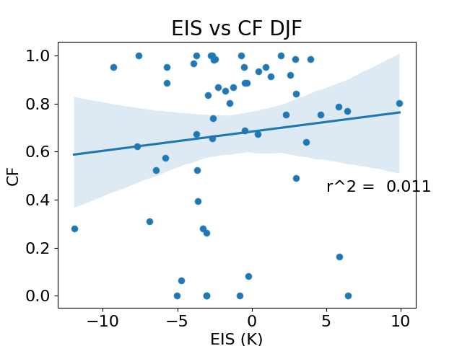
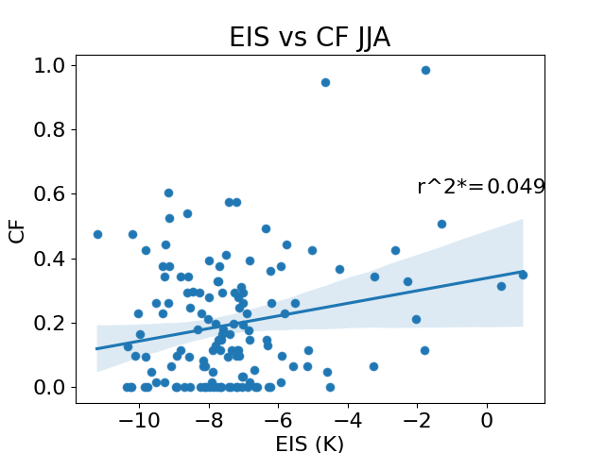
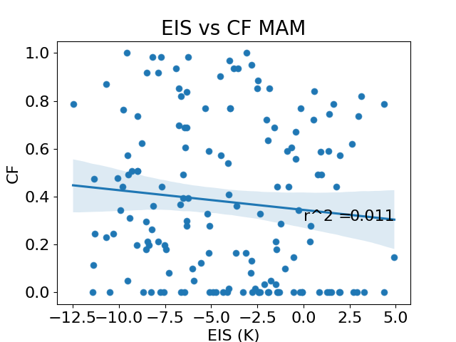
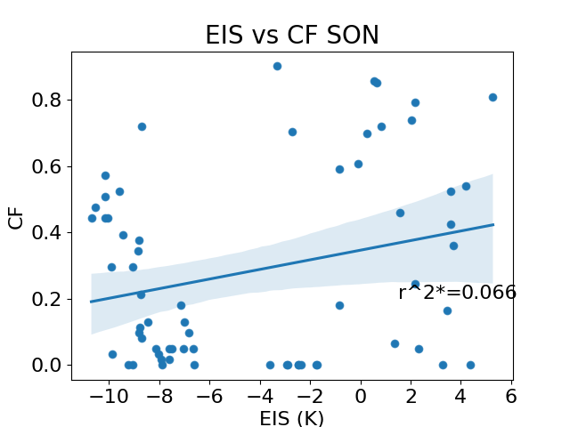
Results
The regression between EIS and Cloud Fraction when separated by season

Slide 9
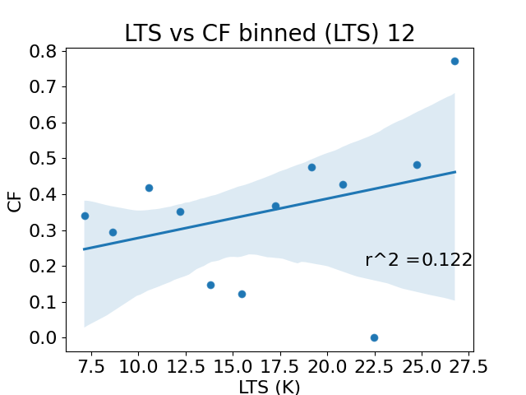
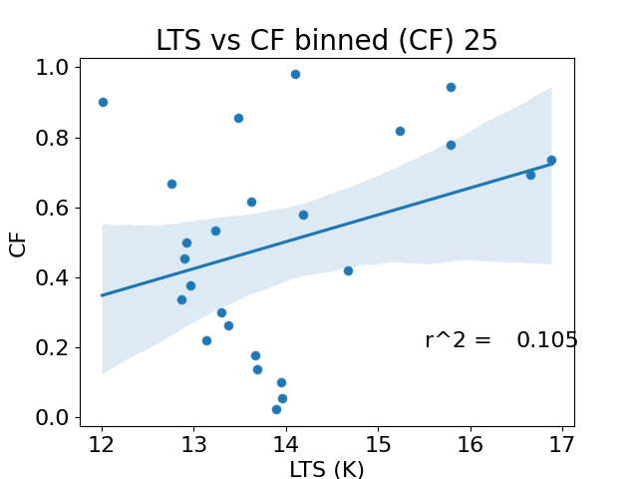
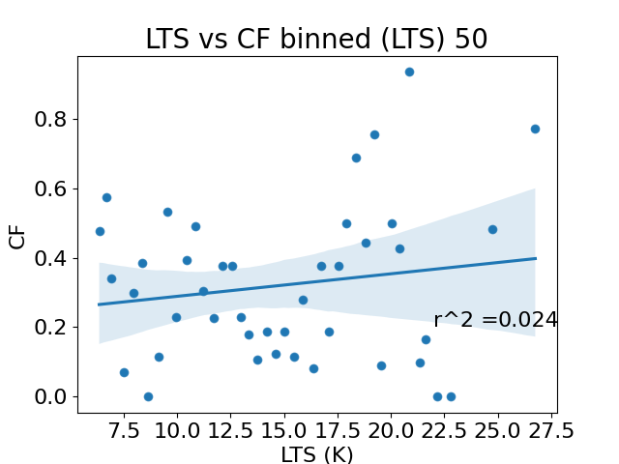
Results
The regression between LTS and Cloud Fraction where the LTS values are in intervals (12,25,50)

Slide 10
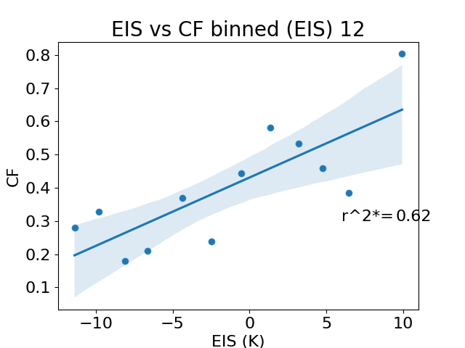
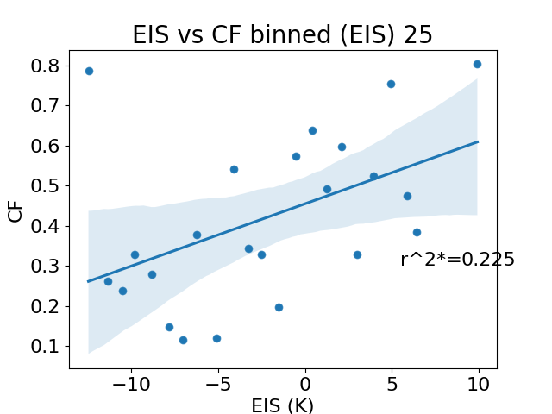
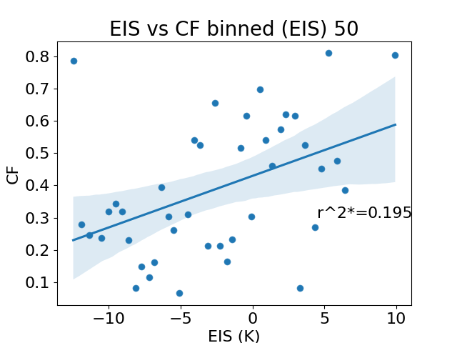
Results
The regression between EIS and Cloud Fraction where the EIS values are in intervals (12,25,50)

Slide 11
Conclusions
EIS does not have a correlation with Cloud Fraction
LTS likely does not have a correlation with Cloud Fraction
There is no major seasonality
Grouping EIS into levels increases the relationship dramatically

Slide 12
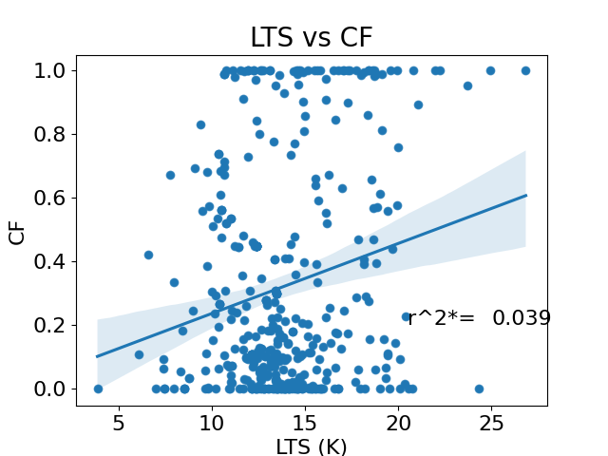
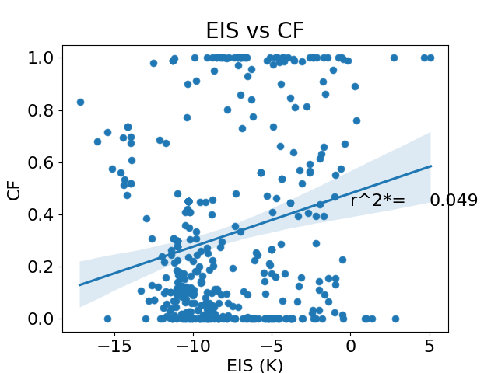
Future Work
The regression between LTS and Cloud Fraction and EIS and Cloud Fraction using ERA5

Slide 13

Thank You

Slide 14
References
Klein, Stephen A., and Dennis L. Hartmann. “The Seasonal Cycle of Low Stratiform Clouds.” Journal of Climate, vol. 6, no. 8, 1993, pp. 1587–1606., https://doi.org/10.1175/1520-0442(1993)006&lt;1587:tscols&gt;2.0.co;2.
Painemal, David, et al. “An Overview of Atmospheric Features over the Western North Atlantic Ocean and North American East Coast—Part 2: Circulation, Boundary Layer, and Clouds.” Journal of Geophysical Research: Atmospheres, vol. 126, no. 6, 2021, https://doi.org/10.1029/2020jd033423.
Painemal, David, et al. “Reducing Uncertainties in Satellite Estimates of Aerosol–Cloud Interactions over the Subtropical Ocean by Integrating Vertically Resolved Aerosol Observations.” Atmospheric Chemistry and Physics, vol. 20, no. 12, 2020, pp. 7167–7177., https://doi.org/10.5194/acp-20-7167-2020.
Sorooshian, Armin, et al. “Aerosol–Cloud–Meteorology Interaction Airborne Field Investigations: Using Lessons Learned from the U.S. West Coast in the Design of Activate off the U.S. East Coast.” Bulletin of the American Meteorological Society, vol. 100, no. 8, 2019, pp. 1511–1528., https://doi.org/10.1175/bams-d-18-0100.1.
Sorooshian, Armin, et al. “Atmospheric Research over the Western North Atlantic Ocean Region and North American East Coast: A Review of Past Work and Challenges Ahead.” Journal of Geophysical Research: Atmospheres, vol. 125, no. 6, 2020, https://doi.org/10.1029/2019jd031626. Wood, Robert, and Christopher
S. Bretherton. “On the Relationship between Stratiform Low Cloud Cover and Lower-Tropospheric Stability.” Journal of Climate, vol. 19, no. 24, 2006, pp. 6425–6432., https://doi.org/10.1175/jcli3988.1.
Links to ACTIVATE Datasets: https://www-air.larc.nasa.gov/missions/activate/index.html
Links to ERA5 Datasets: https://cds.climate.copernicus.eu/cdsapp#!/home

